Slide 1

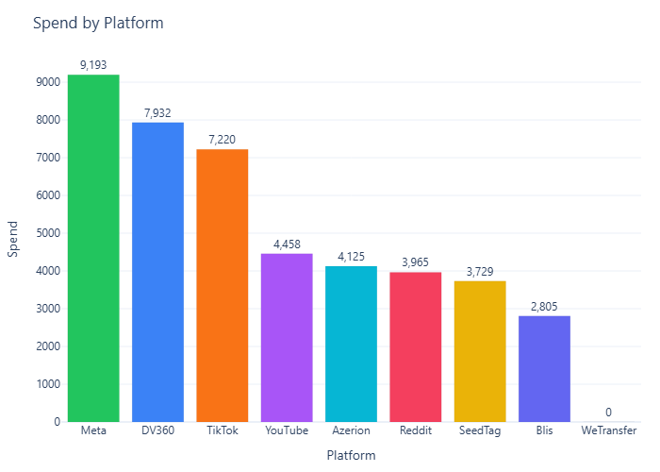
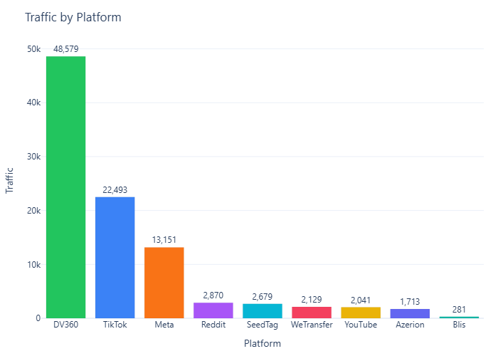
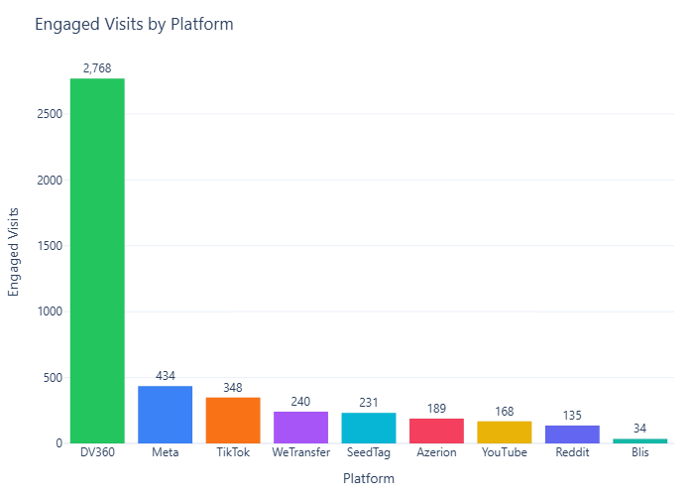
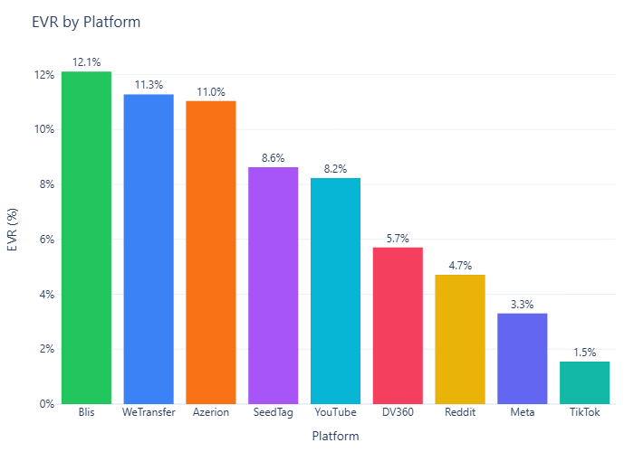
Everyone Can
Contributes 0.2% of this campaign’s engaged visits this week.
Engagement rate is 14.9% and moved up WoW.
Highest contribution comes from **DV360**.

